Slide 1
A CASE STUDY ON CEMENT CONCRETE ROAD AT B R PROJET
Presented by
Ganesh G Kamath.
4SU17CV010
Under the Guidance of
Mr. Vinaya Shyam D.
Department of Civil Engineering
SDM Institute of Technology Ujire - 574240

Slide 2
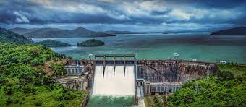
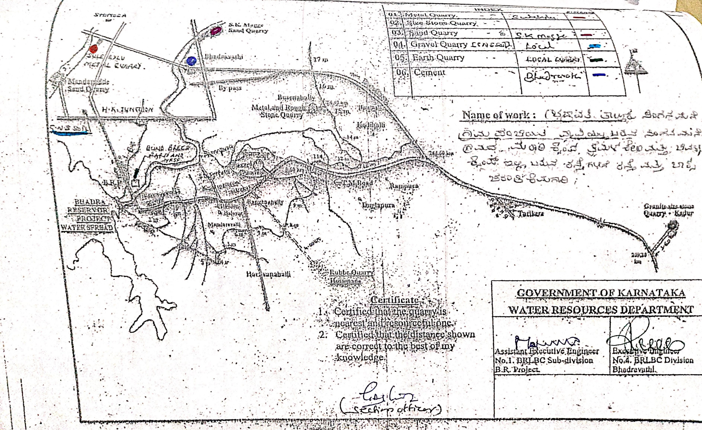
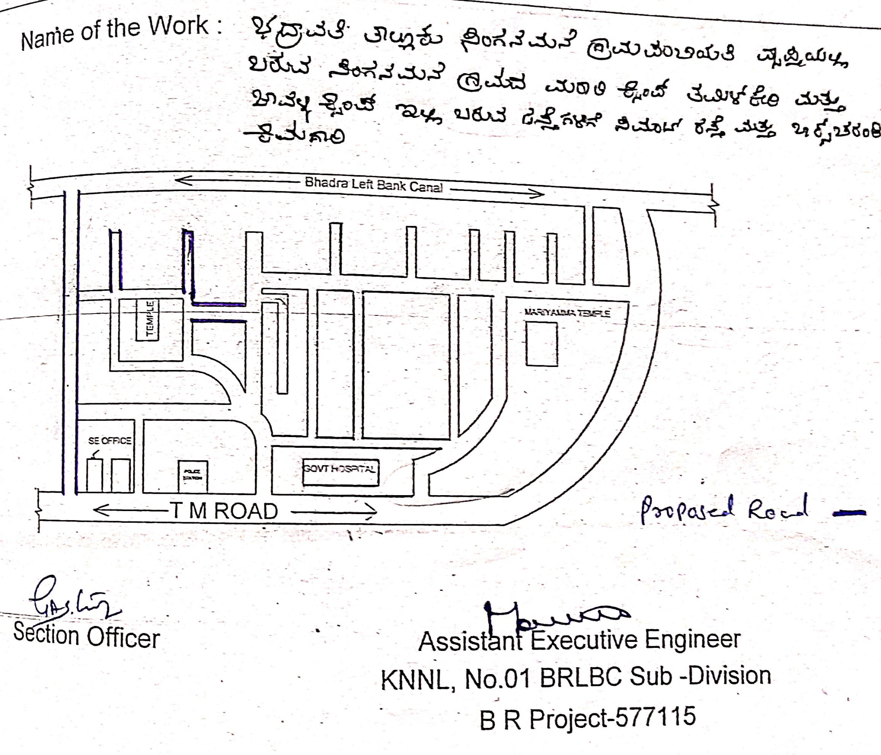
Introduction.
A Case study was done in Bhadra reservoir project (B.R.P)
B.R.Project is a Village, Where main income for people is agriculture, Road is necessary for transportation of crops and food products.
Mr.B.Y, Raghavendra released 2.20Crore to Singanmane gramapanchayath
The Project was Monitored by K.N.N.L No 1 Subdivision B.R.Project.
The Project was Contracted by K.V. Shetty and Company.

Slide 3
Development of a country depends on the connectivity of various places with adequate road network.
Roads constitute the most important mode of communication in areas where railways have not developed much.
India has one of the largest road networks in the world. For the purpose of management and administration, roads in India are divided into following five categories,
National Highway (NH)
State Highway (SH)
Major District Road (MDR)
Other District Road (ODR)
Village Road (VR)

Slide 4
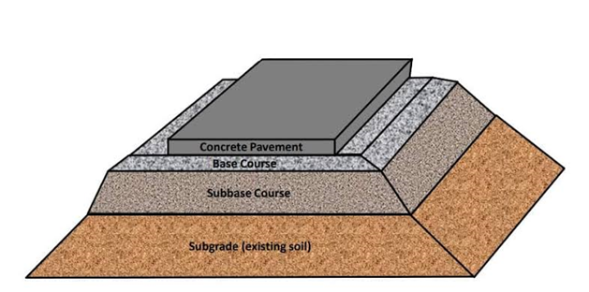
About cement concrete road.
Rigid pavements though costly in initial investment, are cheap in long run because of low maintenance cost, the cost of construction of single lane road varies from 50 to 75 lakh per km in plane area.
Life span is more compare to flexible pavement.
Have high flexural strength.

Slide 5
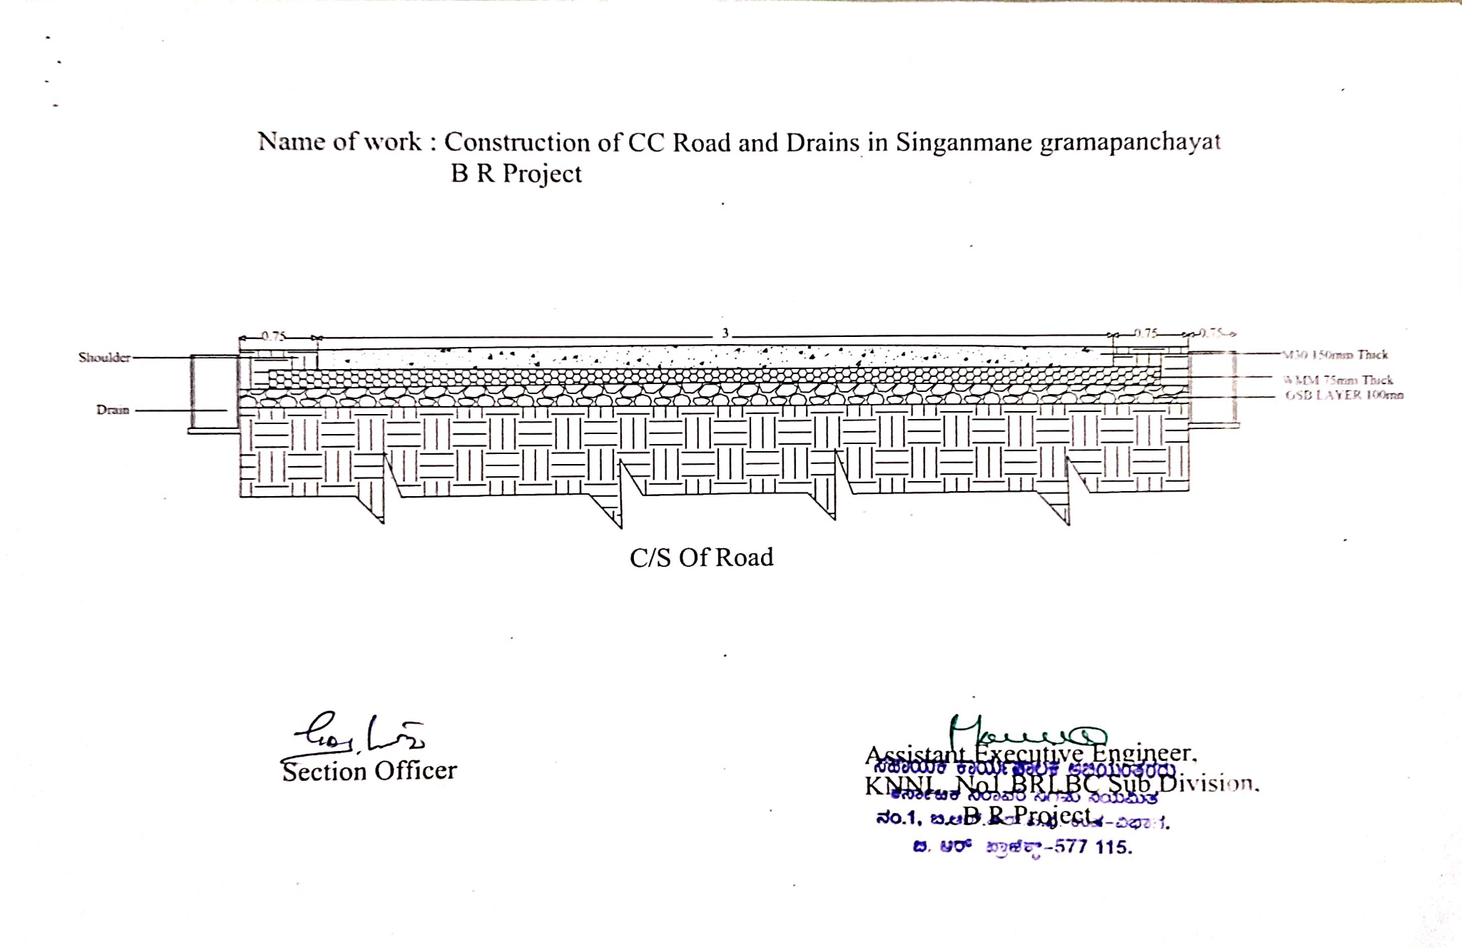
Cross section of road.

Slide 6
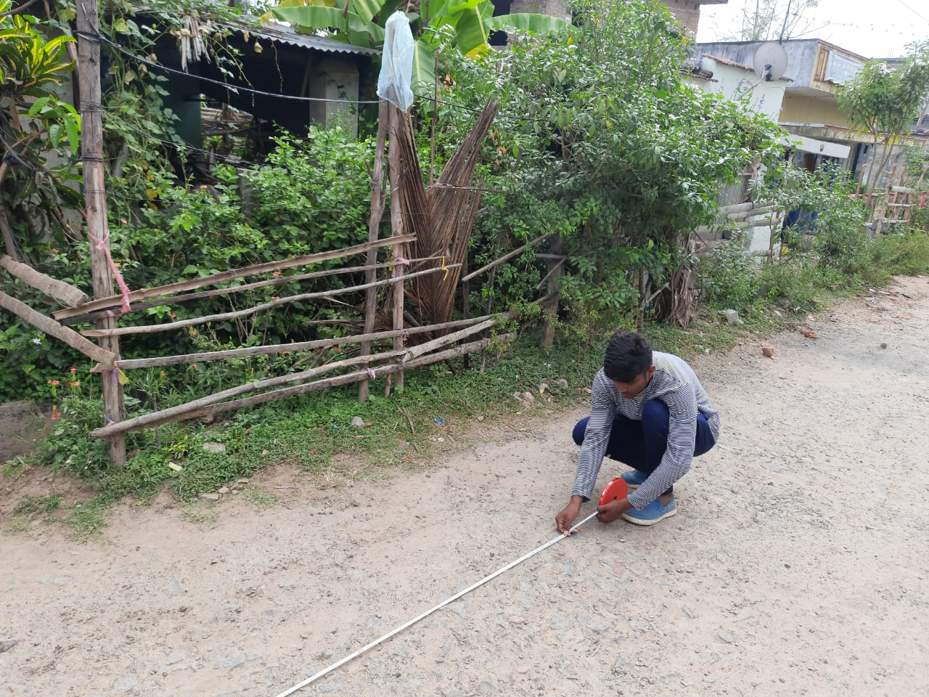
Construction process.
Engineering Survey :
1)Land Survey.
2)Traffic Survey.
1)Land Survey:
Land survey is conducted by using TAPE which has given from the department and then land is divided in two parts i.e carriageway and construction of drain.

Slide 7
2) Traffic Survey:
Traffic survey Was conducted by K.N.N.L No-1 Subdivision.
SLNO | TYPE OF VEHICLE | ROAD USAGE PER DAY
1 | TRACTOR | 10
2 | TILLER | 15
3 | CAR | 3
4 | BIKE | 30
5 | HEAVY VEHICLE | ----
6 | BICYCLE AND BULLOCK CART | 6

Slide 8
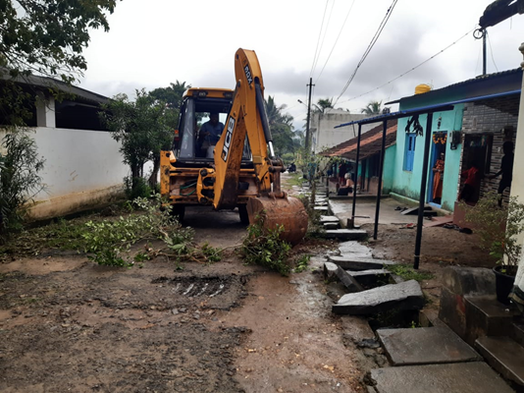
Construction process
1. Preparation of subgrade:
1. Earth Excavation (scarify).
2. Rolling on subgrade by roller.

Slide 9
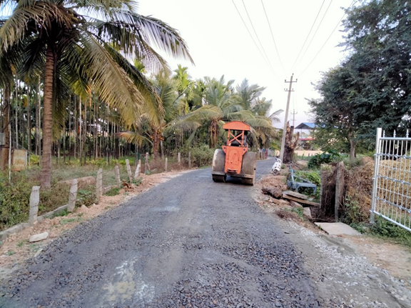
2. Preparation of base:
i. Granular sub-base.
ii. Water mix macadam.
iii. Concrete base.

Slide 10
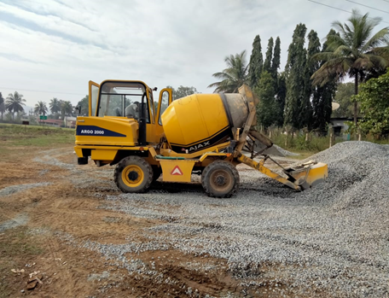
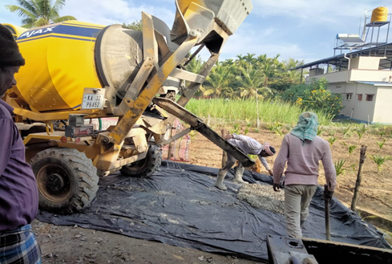
3.Material mixing and placing of concrete:
Loader fad equipment is used for mixing the concrete ingredients (cement,fine aggregate, coarse aggregate and water) in distinct amount.

Slide 11
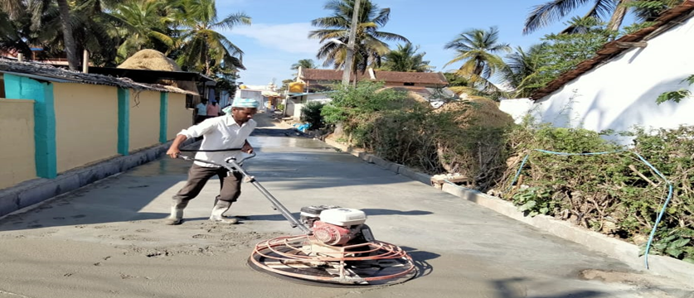
4.Compaction
Purpose of compaction is to pull out the air voids and make concrete harden.

Slide 12
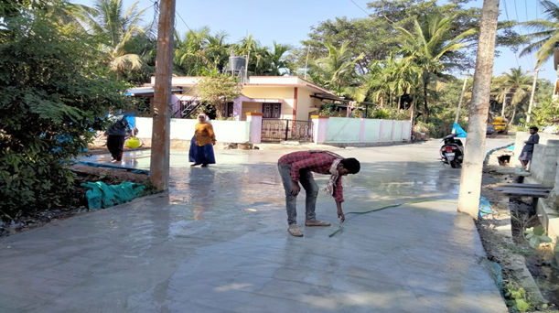
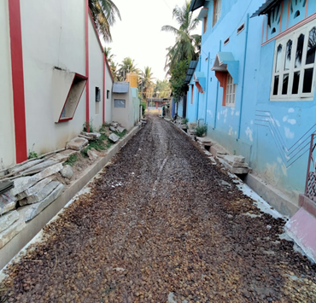
5.Curing
Curing is a method to control the effect of heat under hydration process.Curing is done for 28 days, till concrete gets its strength.

Slide 13
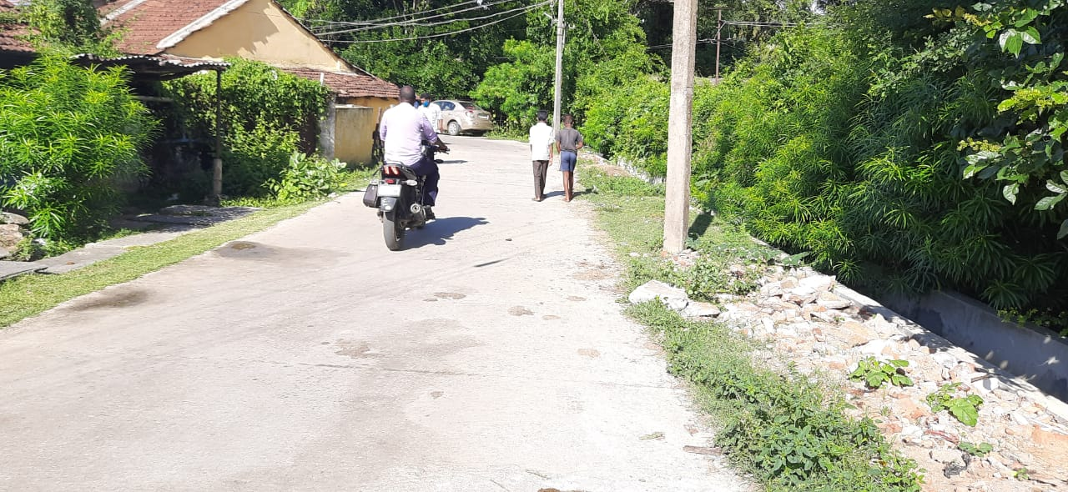
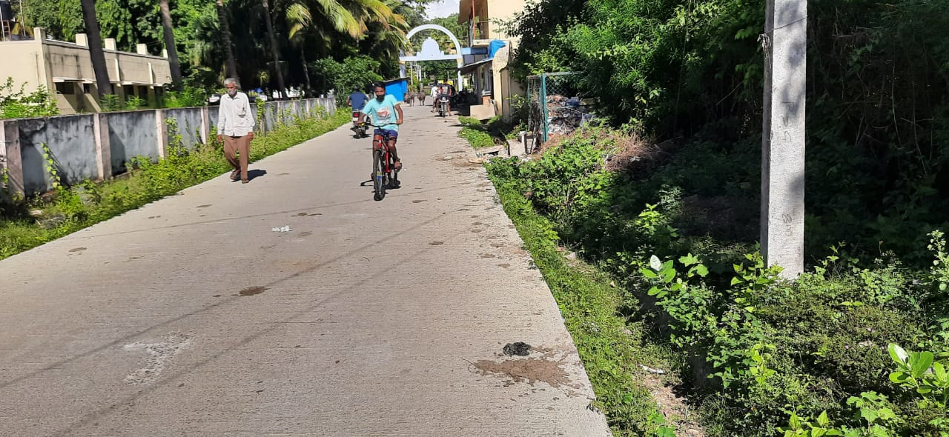
6.Open to the traffic
Generally after a month, road should be open to traffic. If rapid hardening cement is used road may be open for traffic in 7 days.

Slide 14
Materials And Equipment Used
Materials:
Cement.
Fine Aggregate.
Coarse Aggregate.
Water.
Equipment:
Loader fad(ajax)
Vibrator
Sieving screen
Lorry
Tractor
Formwork plywood sheets
Water tanker
Tipper

Slide 15
Rate analysis.
SLNO | PARTICULAR | NUMBER | RATE (RS)
1 | CEMENT BAG | 1 BAG | 350.00
2 | M SAND | 1 CFT | 55.00
3 | COARSE AGGREGATE | 1 CFT | 30.00
4 | TANKER,TROLLEY,TRACTOR | 1 MONTH | 30,000.00
5 | COMPACTION ROLLER | 1 MONTH | 30,000.00
6 | LOADER FAD (AJAX) | 1 FT | 8.00
7 | POLYTHENE SHEET | 1 SQFT | 25.00
8 | EXCAVATOR | 1 HOUR | 750.00
Department of civil engineering

Slide 16
Estimation.
SLNO | PARTICULAR | NUMBER | LENGTH | WIDTH | HEIGHT | QUANTITY | Remarks
1 | SUBGRADE | 1 | 1000 | 4.5 | -- | 4500.00 Sqm | 1000X4.5 = 4500
2 | BASE COURSE (GSB & WMM) | 1 | 1000 | 4.5 | 0.175 | 787. 50cum | 1000X4.5X0.175 = 787.50
3 | BASE | 1 | 1000 | 3 | 0.15 | 450 .00cum | (1:0.75:1.5) (M30 Grade)
SLNO | PARTICULAR | QUANTITY | Rate/cum | TOTAL AMOUNT
1 | SUBGRADE | 4500.00 Sqm | 25.20 | 1,13,400.00
2 | BASE COURSE (GSB & WMM) | 787. 50cum | 2102.10 & 2172.45 | 33,66208.125
3 | BASE | 450 .00cum | 7488.90 | 33,70,005.00
TOTAL COST : 68,49,614.000
Department of civil engineering

Slide 17
Summary.
Dowel Bars are not used in the road because it is village road.
Transverse joints are provided.
Longitudinal joints are not provided as its carriage width is only 3m.
The initial cost of rigid pavement is expensive when compared to flexible pavement.
Overall cost of the project is Rs 68,49,614.000 /-
Department of civil engineering

Slide 18
Thank you
Department of civil engineering

